Slide 1
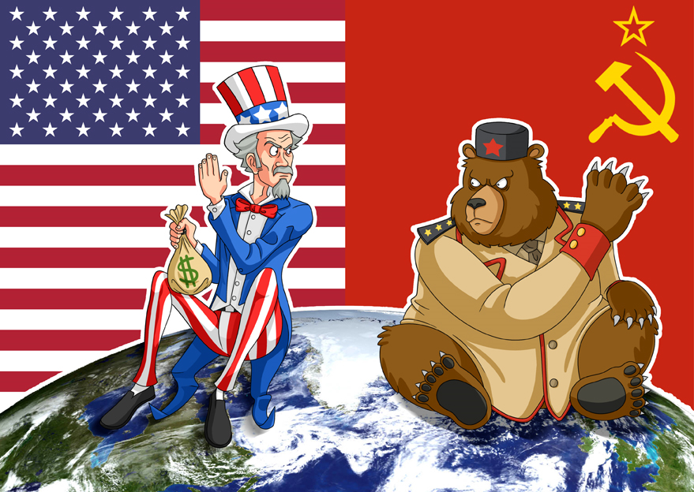
Canada and THE COLD WAR
Subtitle

Slide 2
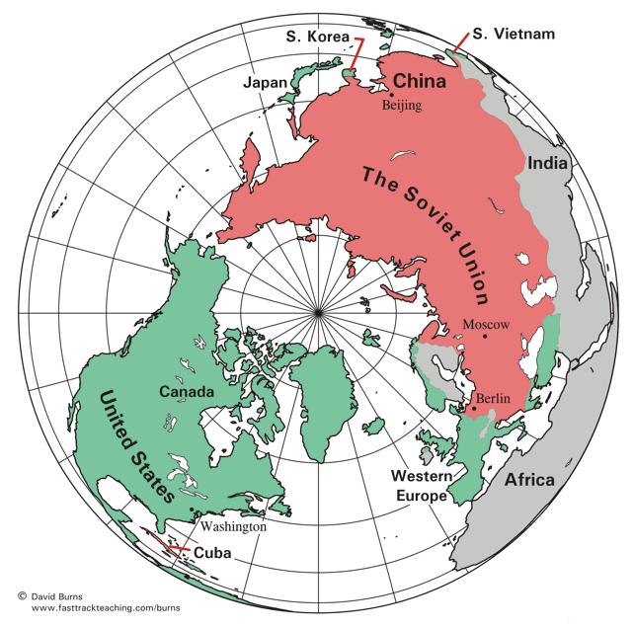
POST WAR REALITY
After WWII, Canada aligns itself with the US but attempts to maintain its sovereignty
The challenge: how can Canada meet its international responsibilities and also maintained its independence

Slide 3
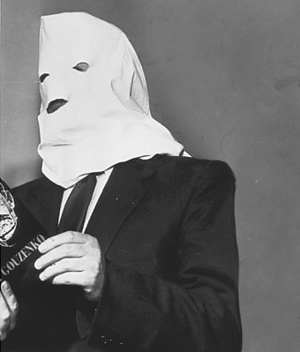
Spies IN OUR MIDST
Igor Gouzenko - a clerk at the Russian embassy stole papers proving that the Russians had a spy network in Canada
Did not get attention initially when he confessed
Eventually a ring of Soviet spies were arrested and 8 of 18 were found guilty and imprisoned
Russians were after The Bomb, Canada was in the middle

Slide 4
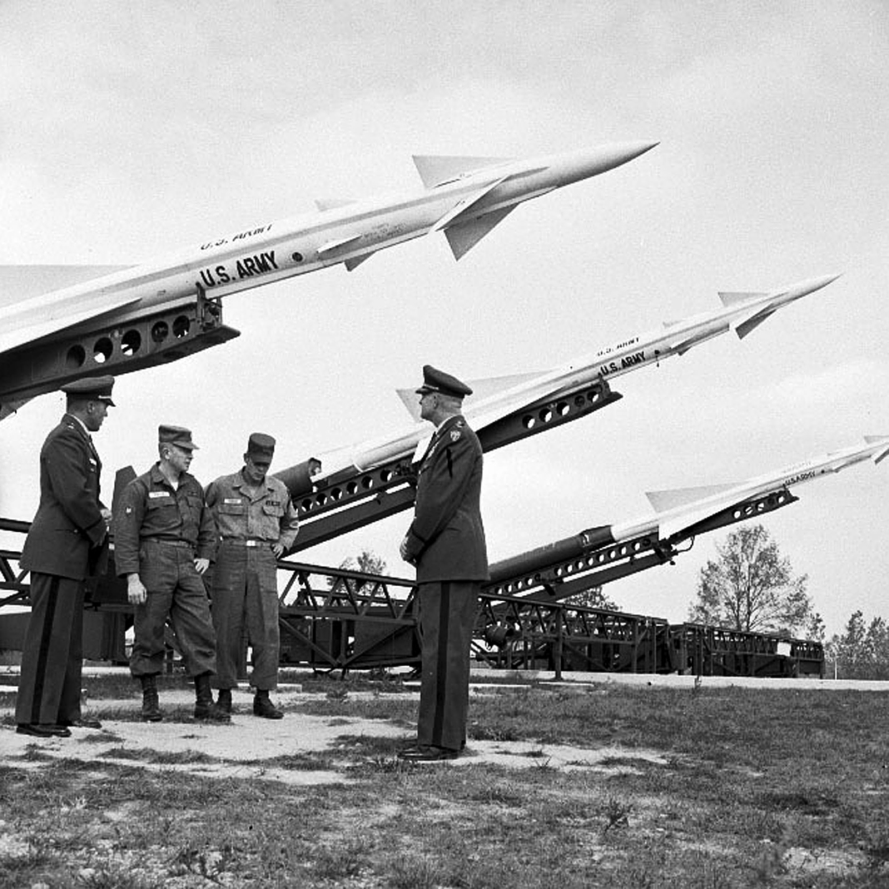
U.S.A. v. U.S.S.R.
Tension between the U.S. and the USSR following WWII
Didn’t want open war
Used spies (espionage)
Stockpile weapons - conventional, nuclear, biological and chemical

Slide 5
COLD WAR BEGINS
U.S. and U.S.S.R. = Superpowers
Each was able to inflict massive destruction, especially through the use of nuclear war (mutually assured destruction - M.A.D.)
Capitalism | Communism
United States (Canada, Britain) | Soviet Union (China)
Based on private ownership Business for profit | Government controls all industry and profit
Freedom of speech Multiple political parties | Political opposition not tolerated One party system
NATO - the “free, democratic West,” dominated by the United States | WARSAW PACT - Eastern Europe and USSR - Iron Curtain

Slide 6
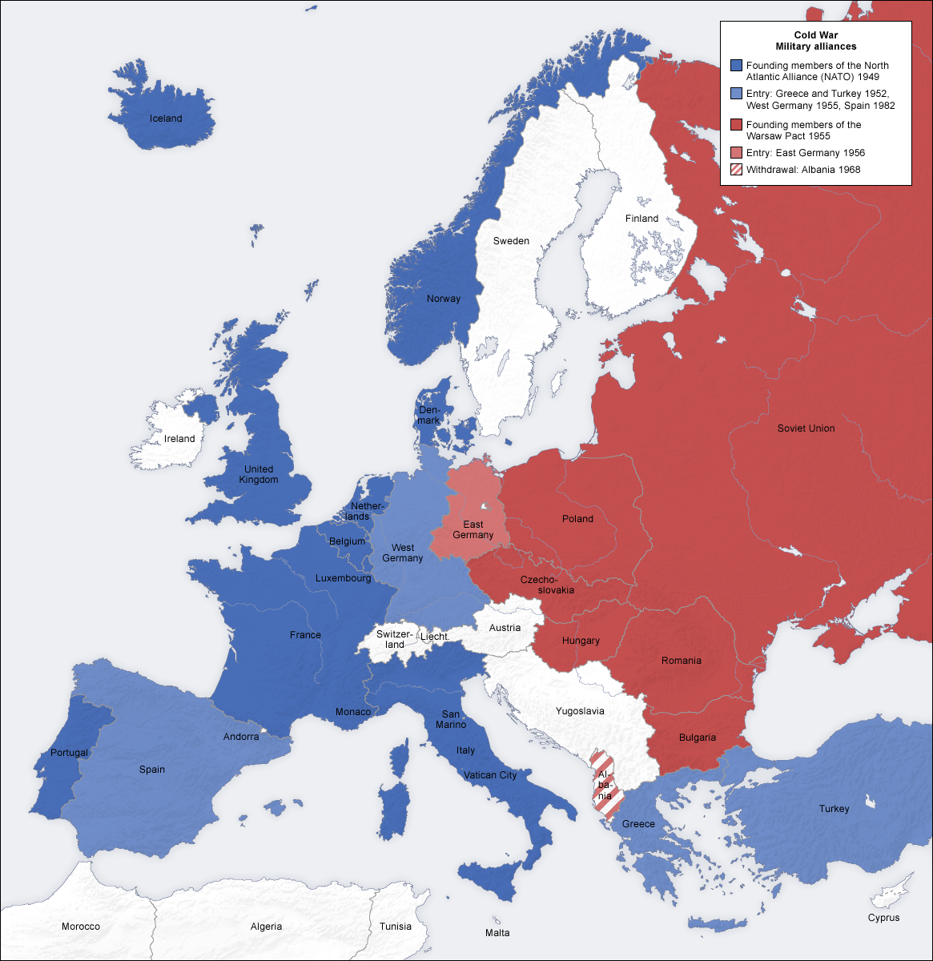
COMMUNISM SPREADS
Soviets expansion into eastern Europe after the Second World War created a buffer zone against the west
1949 - Communism in China
Led by Mao Zedong- Chairman Mao

Slide 7
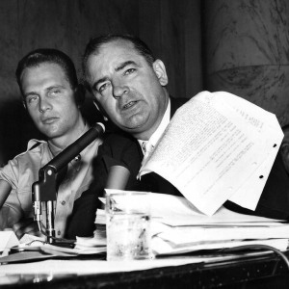
COMMUNISM in THE U.S.A.
U.S. formed Committee on Un-American Activities to route out Communism
Communist witch hunts in U.S.
Led by Senator Joseph McCarthy
Suspected communists could be persecuted, fired and blacklisted

Slide 8
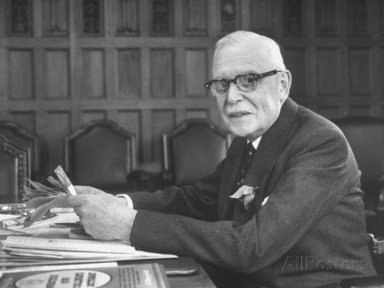
COMMUNISM IN CANADA
Prime Minister St. Laurent refused to outlaw communism
Laurent didn’t want to impose a dictatorship
Many union leaders came under suspicion

Slide 9
Meanwhile in quebec
Premier Duplessis took stand against the Red Menace
Police raided offices and homes looking for communist material
Padlock Law shut down businesses and newspapers
Duplessis blamed communists for bridge collapse in Trois Riveriers

Slide 10
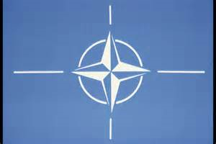
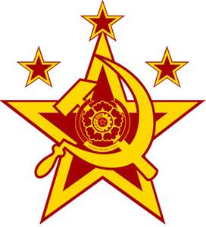
Internationally
NATO and the WARSAW PACT
1949 NATO - North Atlantic Treaty Organization formed to defend western countries from the invasion of the Soviet Union
Members: Canada, United States, Great Britain and other western european nations (see page 195)
Alliance system in place NATO accepted West Germany
Soviet Union formed Warsaw Pact in response 1955 (see page 195)

Slide 12
CANADA And NATO
PM Mackenzie King defended Canada’s decision to join NATO...“It is vital to the defense of freedom to maintain military strength on the side of freedom”
Maintain army brigade and air squadrons in Europe
Built and supplied Military bases overseas
Canadian ships tracked Soviet subs
Canada adopted the defence policy of its allies

Slide 13
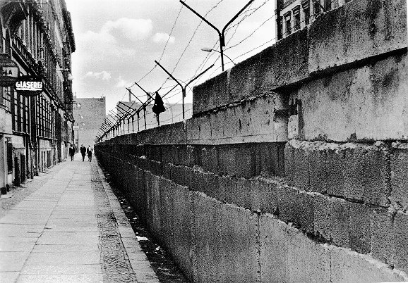
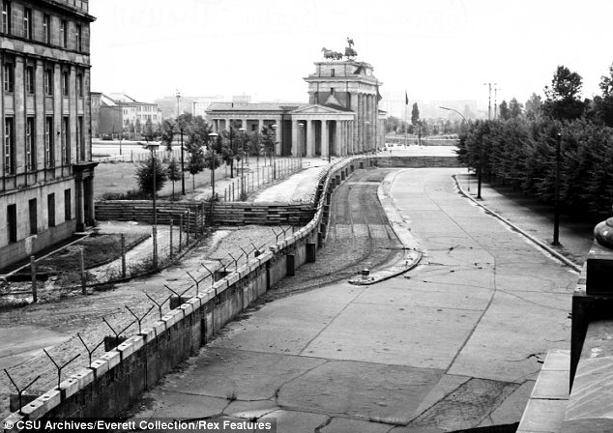
BERLIN WALL
Important symbol during the Cold War
1961 Communist East Germany built wall dividing East and West Berlin to prevent East Berliners from escaping to capitalist West Berlin
Fell Nov 9 1989

Slide 14
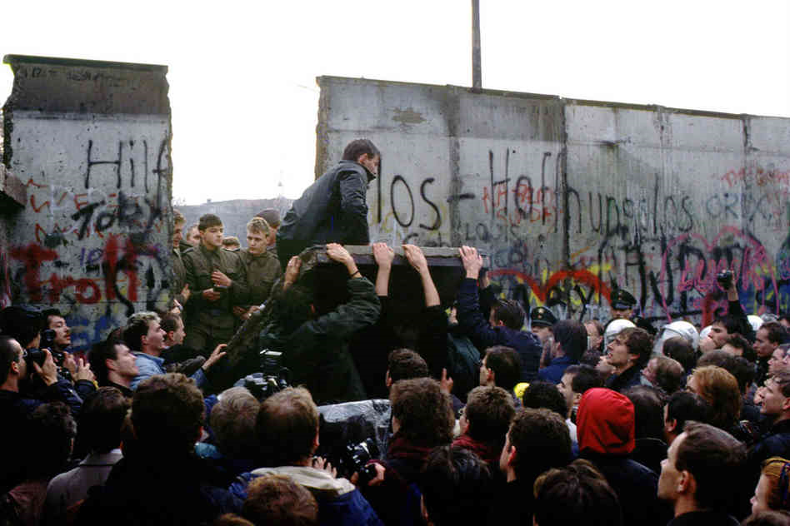
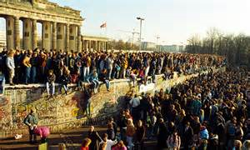
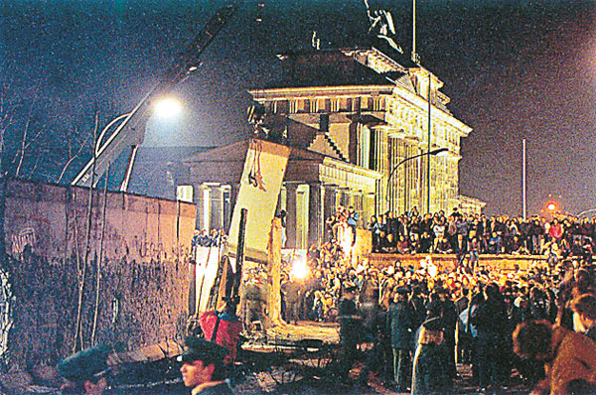
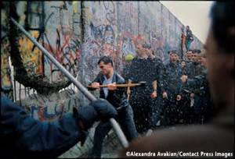

Slide 15
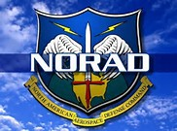
NORTH AMERICAN DEFENSE
North America vulnerable to long-range bombers
3 lines of radar defence - The Pinetree Line, the Mid-Canada Line and the DEW (Distant Early Warning) Line
the stations were built and manned by U.S. military- designed for early detection of nuclear strikes
missiles with nuclear warheads that could reach cities within 30 minutes made stations obsolete
1957 NORAD (North American Air Defence) used planes , missiles and radar centered in Cheyenne and North Bay, ON in Canada
Canadians fearing a rain of nuclear bombs prepared nuclear shelters and attack procedures

