Slide 1
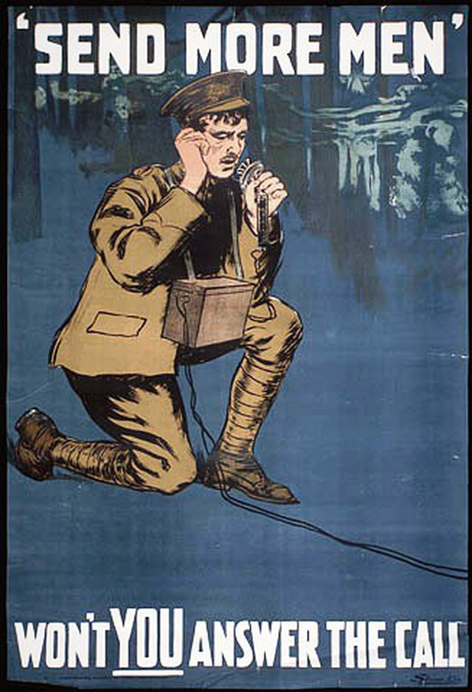
Social Studies 11 Unit 2 Canada Emerges in the 20th Century Canada and World War One

Slide 2
First things First
Britain controlled Canada’s foreign policy
No choice but to join the war

Slide 3
Back in Canada…
Most English Canadians supported the war
Held patriotic feelings towards the British Empire
French Canadians were not as excited

Slide 4
Canada’s Response
Prime Minister Borden promised 25,000 troops
30,000 volunteered in the first month
Women were relegated to supporting roles
Women in armed forces acted as nurses and ambulance drivers behind front lines

Slide 5
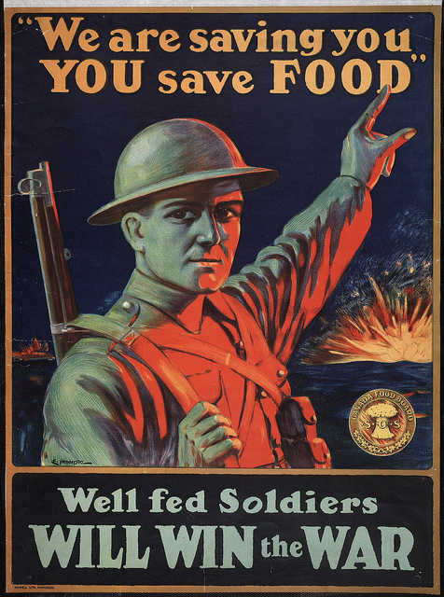

Slide 6
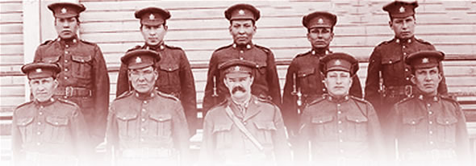
Canada’s Response
Armed forces were reluctant to accept Aboriginals, African- and Japanese Canadians
The few that did join were not promoted

Slide 7
Training the troops
Initial training took place at Valcartier Quebec
Minimal training
Troops were not prepared for combat
32,000 Canadian and Newfoundland
troops departed for Europe

Slide 8
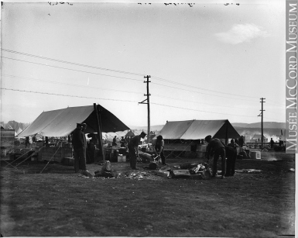
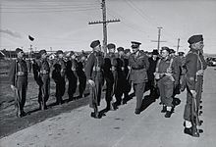
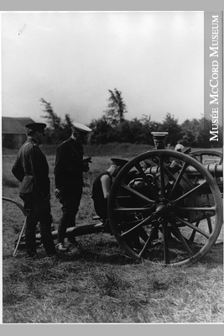
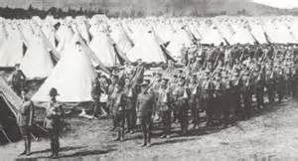

Slide 9
Creating an Identity
CEF “ Canadian Expeditionary Force”
National identity was fostered because men of different regions of Canada worked and trained together
Fought as an independent unit

Slide 10
Back at home…
WAR MEASURES ACT
Borden introduced act which allowed government to control the county’s affairs
granted authority to do everything necessary “ for the security, defense, peace, order and welfare of Canada

Slide 11
War Measures Act (continued)
government control of economy, manufacture, trade and transportation
could deny Canadian’s their civil liberties
arrests without charges, internment camps, deportation

Slide 12
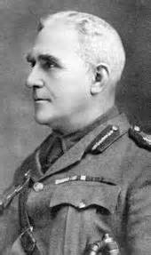
Sam Hughes
named Canada’s Minister of Militia
was put in charge of the armament industry
ineffective administrator
Ross Rifle, poor shell quality were issues that failed to fix

Slide 13
Issued $170 million in contracts / $5.5 million dollars in shells were produced
Issued contracts to friends who profited form war
Fired in 1916 after being knighted by George V

Slide 14
War & the Canadian Economy
1916 Canada’s economy was in full swing
hundreds of thousands of Canadians were employed making shells, ships and airplanes
Canadian products in demand: lumber, nickel, copper, lead, wheat and beef
Goods became expensive
Wages didn’t increase to match rising costs
Goods became scarce at home

Slide 15
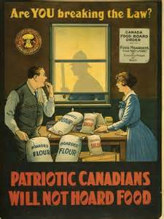
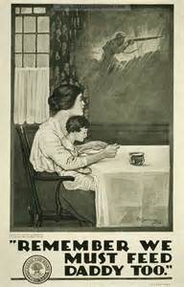

Slide 16
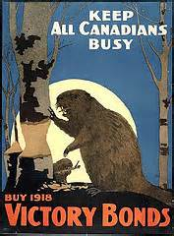
Funding the War Effort
The Canadian government began borrowing money from citizens in order to pay for the increasing costs of the war.
“Victory Bonds” were guaranteed to be repaid after the war.

Slide 17
Funding the War Effort (continued)
Income Tax
well-off citizens were expected to pay 3% of income.
businesses were taxed 4%.
intended as a temporary measure!
18% average today

