Slide 1

Canada, Peacekeeping and THE United Nations

Slide 2
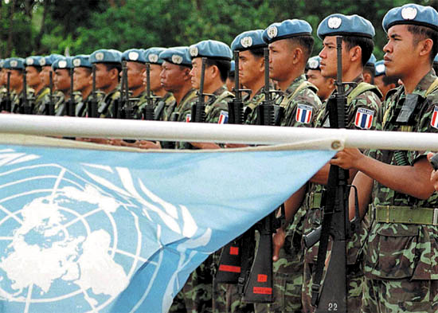
The United Nations
Organized in April 1945 by 51 countries, including Canada
Discussed by Allies during WWII
Purpose –to prevent another world war, maintain peace
Based on collective security; member countries would join together

Slide 3
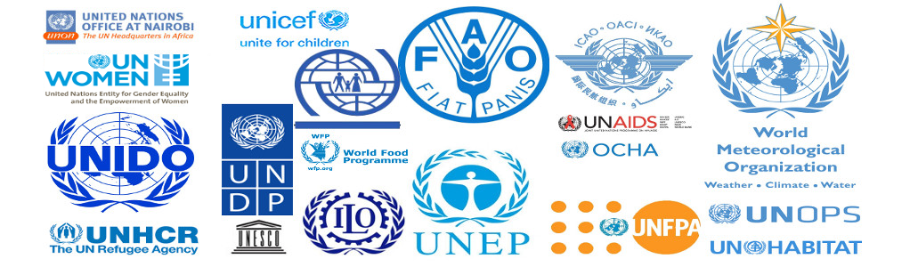
UN Principles
Welcome all peaceful nations
Promote and maintain international peace and security
Encourage and facilitate the development of friendly relations among all nations of the world
Collectively work on economic, social, and humanitarian issues throughout the world

Slide 4
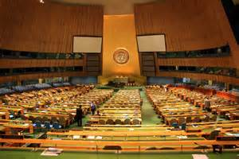
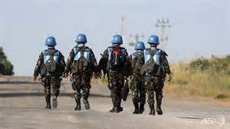
Actions against agGressor nations
Condemn the aggressor through speeches and resolutions
Use economic sanctions, urging members not to trade with the aggressor
Respond militarily by sending in an armed force
  Unlike League of Nations

Slide 5
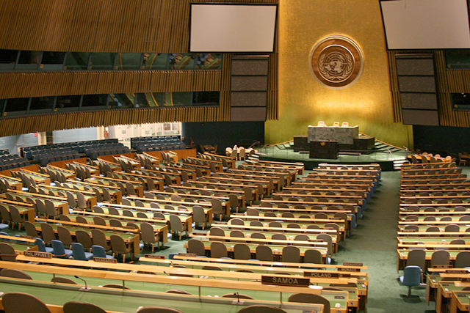
Organization
  General Assembly
  All members, meet at least once a year, general debates and votes

Slide 6
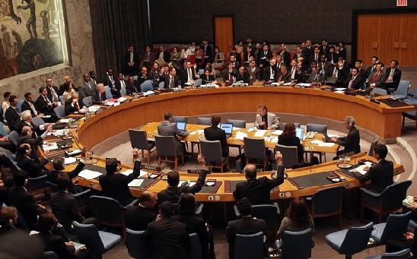
  Security Council
  Responsible for maintaining peace and security
    Five permanent members (USA, Britain, Russia, China, France) with veto power
    Veto power can lead to inaction
  Ten temporary members –nations serve 2-year terms

Slide 7
Other Notable UN AGENCIES
  World Health Organization (WHO)
    Deals with disease and other health issues
  United Nations Children’s Fund (UNICEF)
    Combats child famine and health issues
  International Monetary Fund (IMF)
    Oversees world economy

Slide 8
UN’s UNIVERSAL DECLARATION
OF HUMAN RIGHTS
Human rights –basic rights everyone should have
Adopted unanimously by UN in 1948
“all human beings are born free and equal in dignity and rights”
Response to the Holocaust, WWII
Forbids slavery, torture, arbitrary arrest
Confirms right to life, safety, fair trial, freedom of movement
Enforcement –UN can only draw attention to violations, unable to punish offenders

Slide 9
Korean War
  Korea divided in two after WWII
  Soviet Union controlled North –communist
  Supported by China
USA controlled South -democratic
1950: North Korea invades South Korea
United Nations condemns invasion, approves UN military force to help South Korea
UN force from 15 countries, including Canada, but mostly from the USA

Slide 10
Minister of External Affairs Lester Pearson tried to negotiate a ceasefire
1953: Stalemate, ceasefire, Korea remained divided in two
Increased tensions between Western countries and communist countries
First example of “proxy war”
War fought indirectly between USA and USSR
Approx. 400 Canadians killed, 1200 injured

Slide 11

UN PEACEKEEPING
UN forces used to maintain peace in regions previously at war
Keep two sides apart, prevent further fighting

Slide 12
SUEZ CRISIS (1956)
  Egypt seizes control of Suez Canal from English-French company
  Suez Canal –links Mediterranean and Red Sea
Israel fearful, sends troops, supported by British and French
USSR pledges support to Egypt
USA angry with Israel/Britain/France, sides against USSR
Canada disagrees with British and French actions

Slide 13
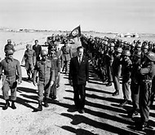
Minister of External Affairs Lester Pearson proposes UN send force to separate two sides, prevent war
UN sends first peacekeepers, led by Canadian general
Peacekeepers and pressure from USA prevents war
Pearson awarded 1957 Nobel Peace Prize

Slide 14
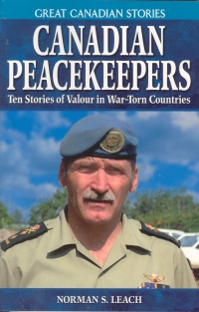
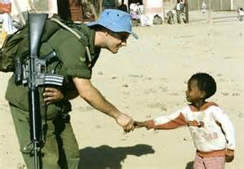
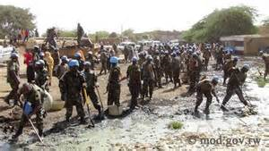
CANADA’s ROLE
  Canada well suited for peacekeeping as a middle power
  Not seen as a threat
  Trusted, able to mediate between parties
  Contributed to every UN peacekeeping mission between 1956-2000
  Participation has decreased since 2000

